Slide 1

Twitter Sentiment Analysis
A Machine Learning Project for Sentiment Classification
Group –
Indra Prasad Chevva
Fnu Mohammed Zayeemuddin

Slide 2

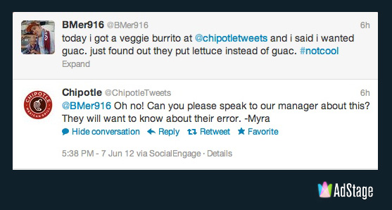
OBJECTIVE:
Classify tweets into positive or negative sentiment based on the text content from Tweets using Machine Learning Algorithm.

Slide 3
PROJECT METHODOLOGY
DOWNLOAD AND EXPLORE THE DATASET FROM KAGGLE
LOAD THE DATA SET
CLEANE THE DATASET
TEXT PREPROCESSING STEPS
SPLIT THE DATA SET INTO TRAINING AND TESTING DATA SETS
TRAIN THE ML MODEL – LOGISTIC REGRESSION
EVALUATE MODEL ON TEST SET
PERFORMANCE EVALUATION – ACCURACY, CONFUSION MATRIX AND CLASSIFICATION REPORT
SAVE THE MODEL FOR DEPLOYMENT

Slide 4
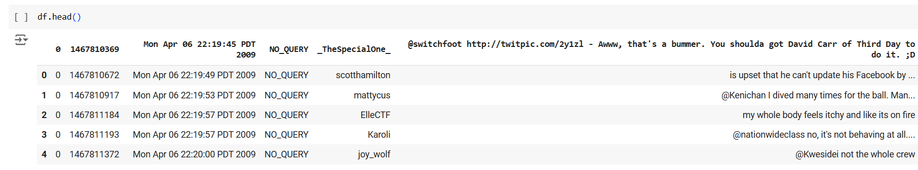
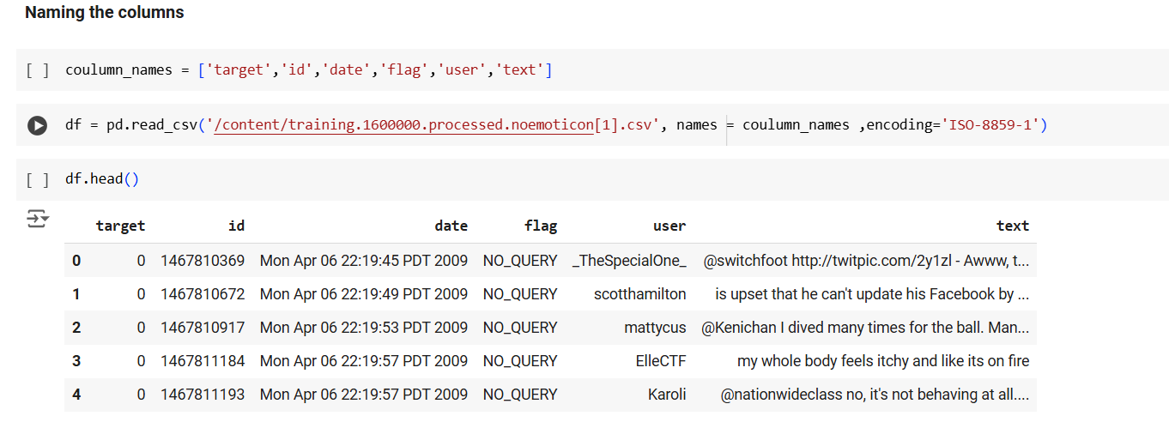
DATA EXPLORATION

Slide 5
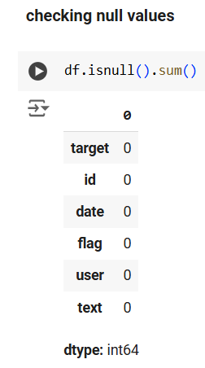
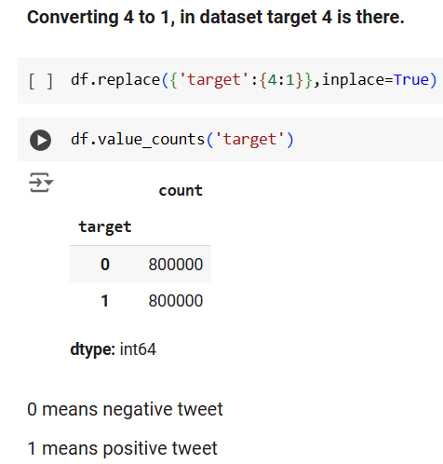
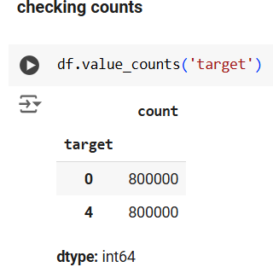
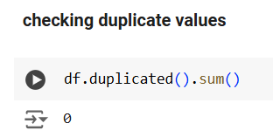
DATA CLEANING

Slide 6
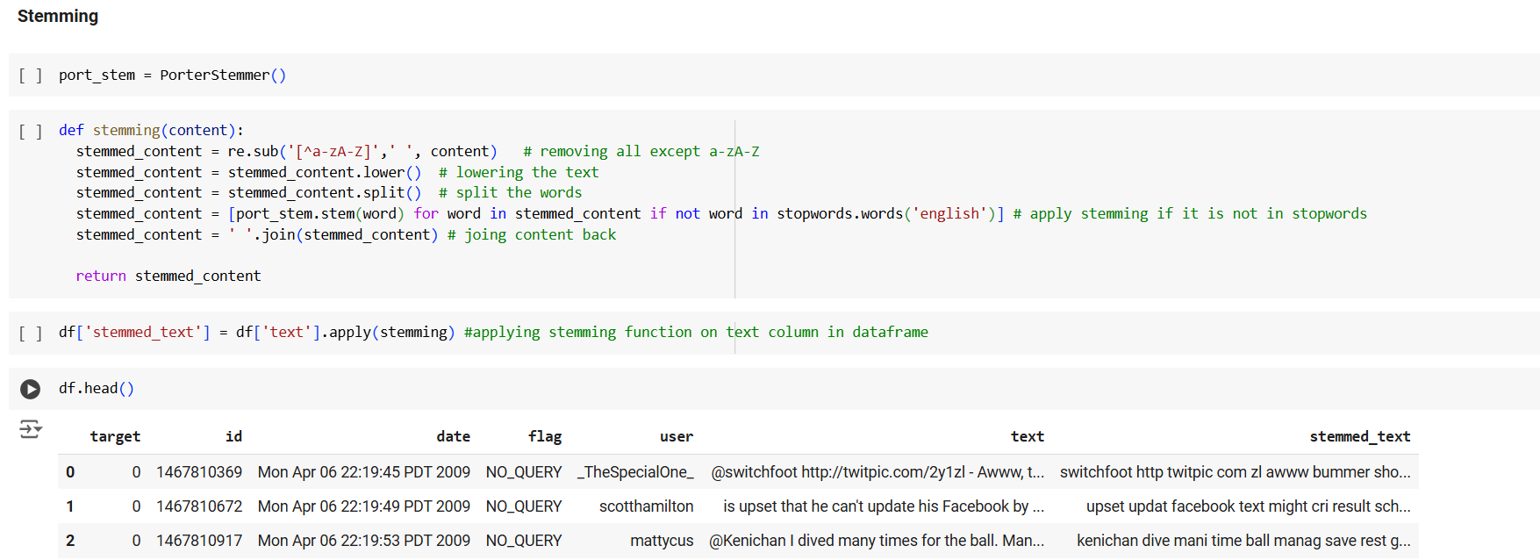
Text Preprocessing

Slide 7
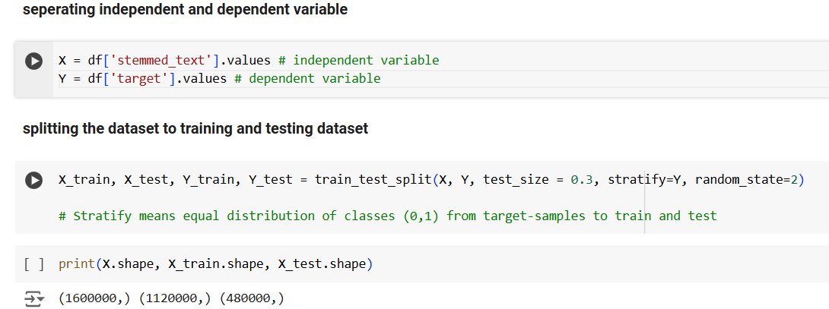
DATA SPLIT

Slide 8
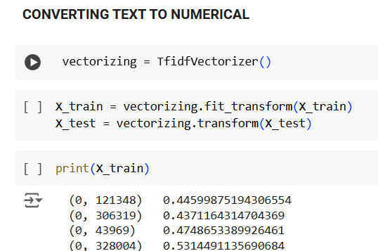
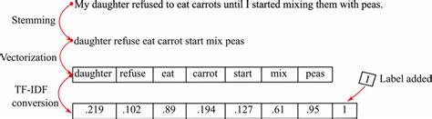
VECTORIZATION
TF-IDF Vectorization:
Converts the text into a numerical representation.
TF (Term Frequency): The number of times a word appears in a document.
IDF (Inverse Document Frequency): Reduces the weight of common words across documents.

Slide 9
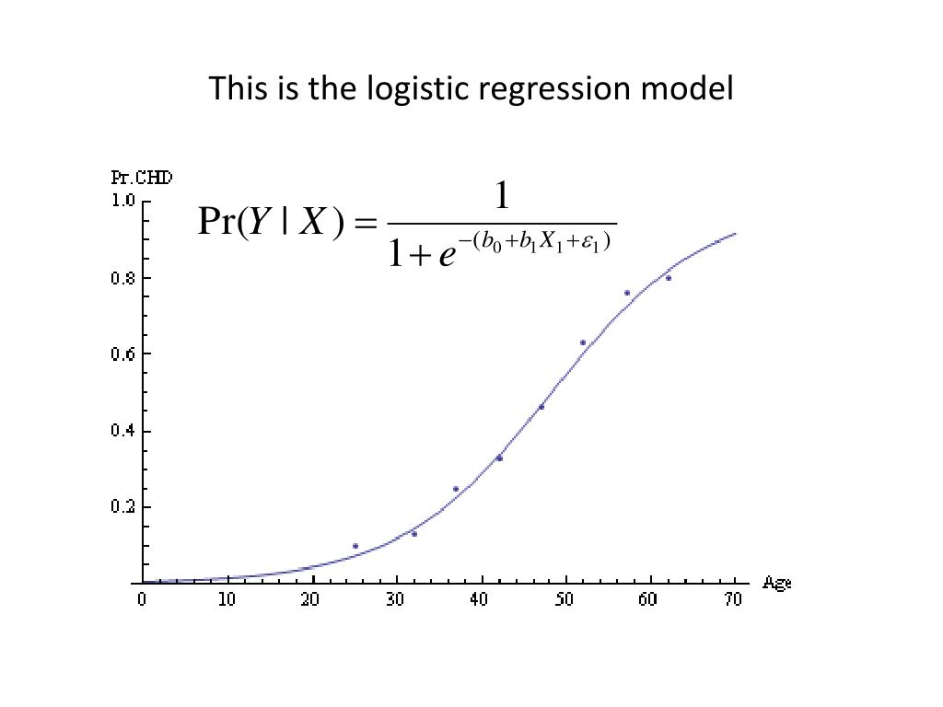
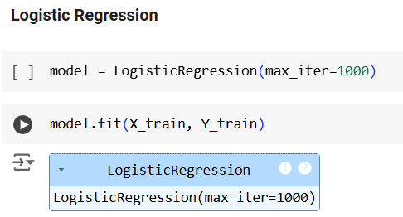
MODELLING

Slide 10
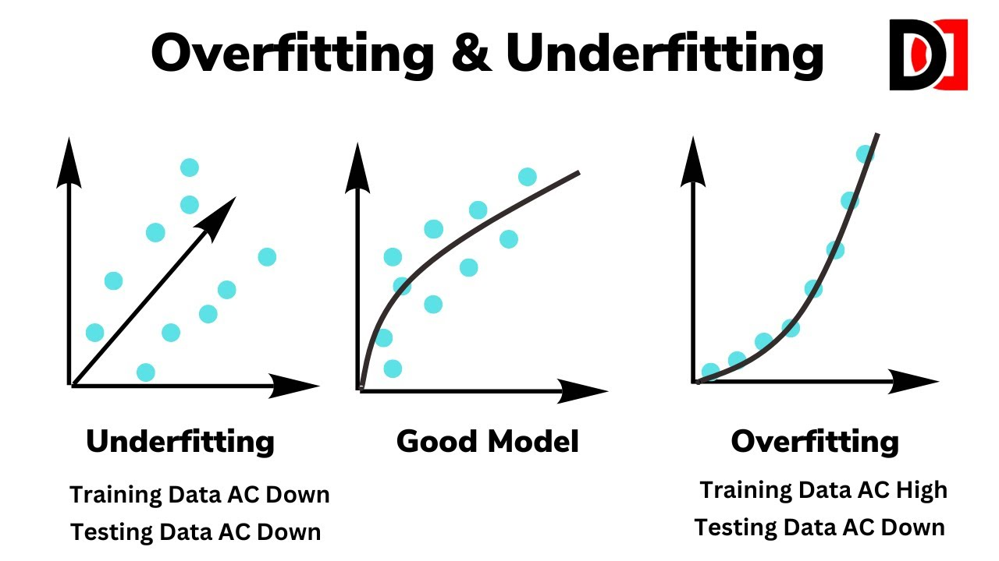
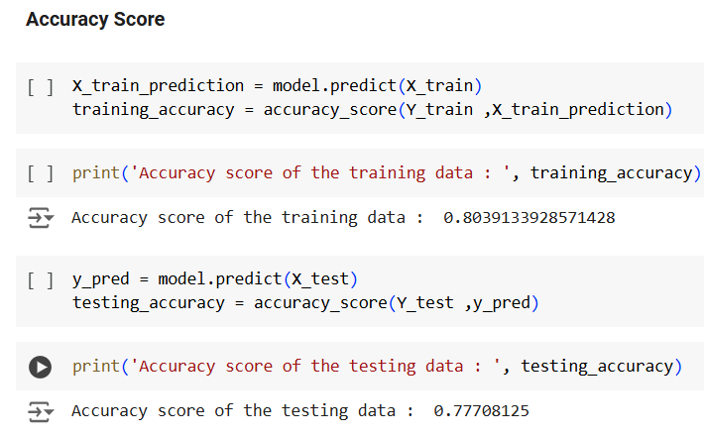
PERFORMANCE EVALUATION-1
TRAINING ACCURACY – 80%
TESTING ACCURACY – 77%
MODEL – GOOD FIT

Slide 11
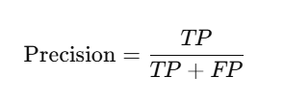
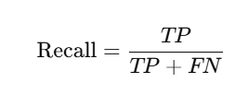


PERFORMANCE EVALUATION - 2
PRECISION :
TP (True Positives): Correctly predicted positive instances.
FP (False Positives): Incorrectly predicted as positive when they are negative.
Interpretation:
High precision means that when the model predicts a positive class, it is likely correct.
RECALL :
TP (True Positives): Correctly predicted positive instances.
FN (False Negatives): Incorrectly predicted as negative when they are actually positive.
Interpretation:
High recall means that the model correctly identifies most of the positive instances, minimizing false negatives.
F1-SCORE:
F1-Score takes both false positives and false negatives into account, so it is a better metric when you need to balance precision and recall.
Interpretation:
High F1-Score indicates that both precision and recall are high, meaning the model performs well on both identifying positives correctly and minimizing false positives and negatives.

Slide 12
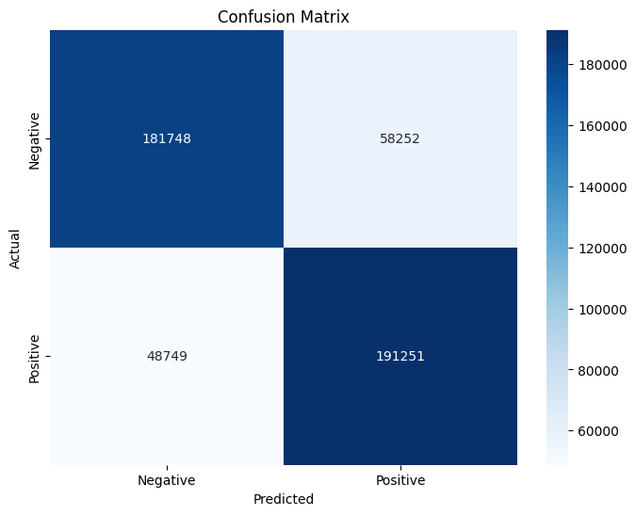
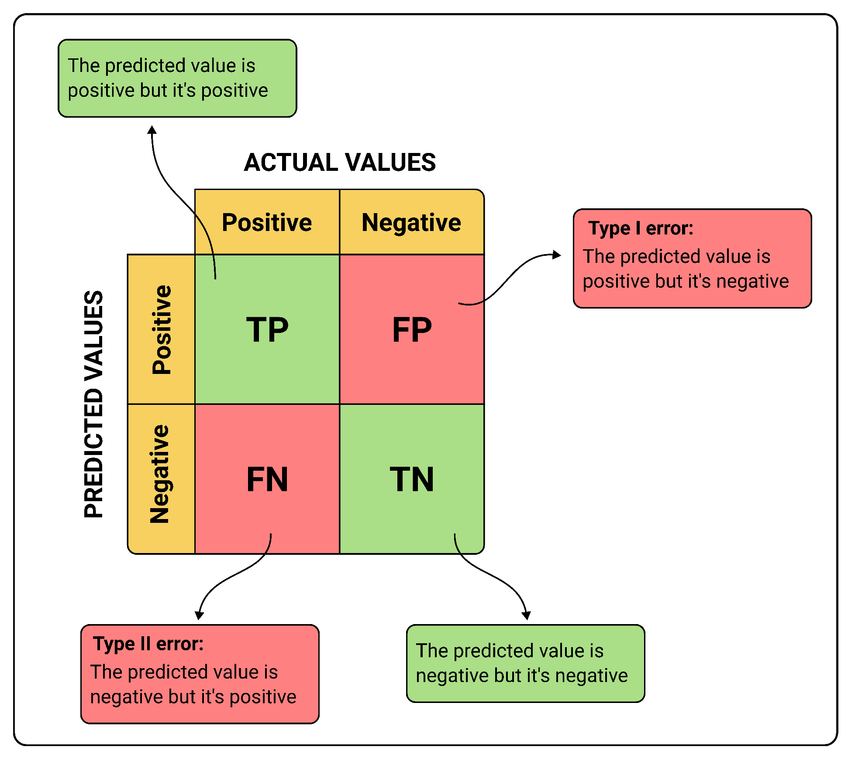
PERFORMANCE EVALUATION-3

Slide 13
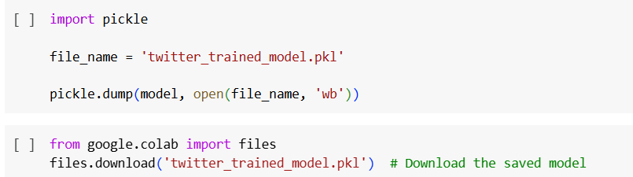
SAVE THE MODEL FOR DEPLOYMENT

Slide 14
FUTURE PROJECT DIRECTIONS
PERFORM CROSS VALIDATION
PERFORM ARTIFICIAL NUERAL NETWORK
PERFORM OTHER MACHINE LEARNING MODELS LIKE XGBOOST, RANDOM FOREST..ETC
PERFORM HYPER PARAMETER TUNING
PERFORM TRANSFER LEARNING TECHNIQUES – BERT ETC

Slide 15

THANKS
ANY QUESTIONS ?

